Slide 1

Face mask detection
By :
Sara Baza
Tasneem sherif
Notes:
Note:
1

Slide 2
Agenda
WHY
HOW
Steps
Target
Architecture
Result
WHAT
Dataset
Notes:
Note:
2

Slide 3
What is our project ?

Slide 4
Which is the target audience ?

Slide 5
Why?

Slide 6
How ?

Slide 7
Computer vision
A scientific filed developed to make computers acquire high-level understanding from digital images

Slide 8
Applications:
Social distance detector
Thermal scanning

Slide 9
Architecture
Load dataset
Train with tensorflow / keras
Phase 1 :
Phase 2 :
Upload image
Detect faces
Show result

Slide 10
Libraries :
Sklearn
matplotlib
Numpy
Tensor Flow
Keras
CNN (MobileNetV2 Architecture)

Slide 11
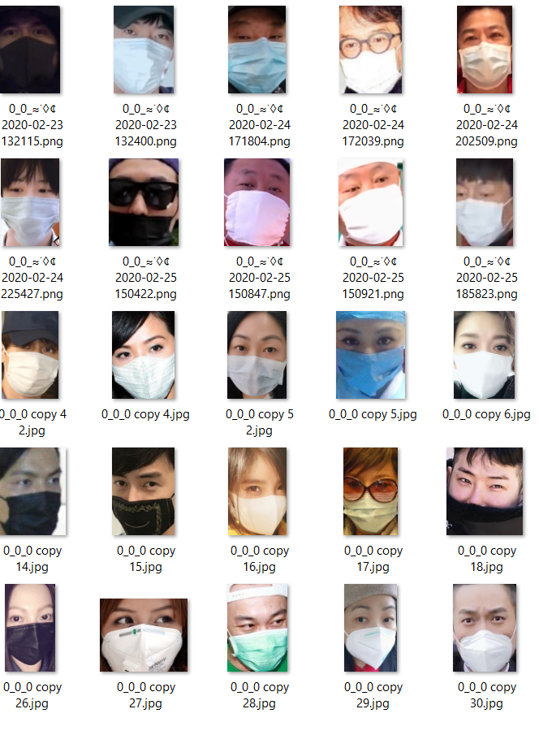
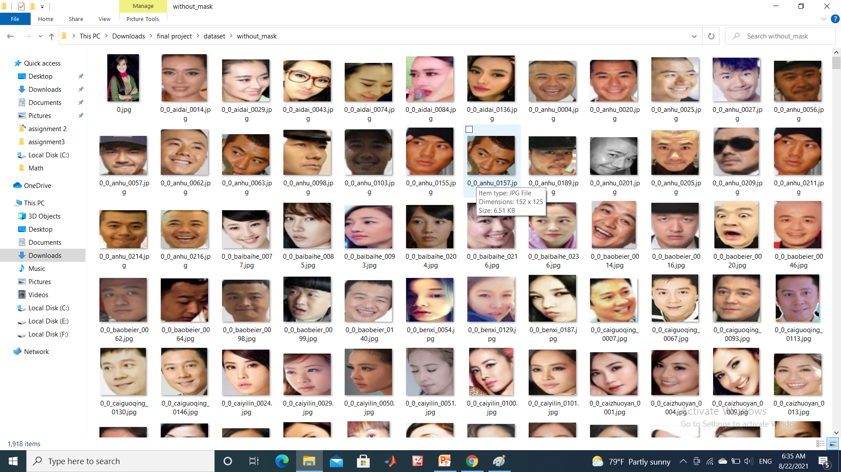
Dataset
Our dataset include 1915 image people with mask and 1918 image without mask
https://github.com/balajisrinivas/Face-Mask-Detection/tree/master/dataset

Slide 12
Project steps
Load dataset
Data preprocess
Train data
Create CNN model
Compile the model
Split into train-test
Make predictions
Plot loss and accuracy

Slide 13
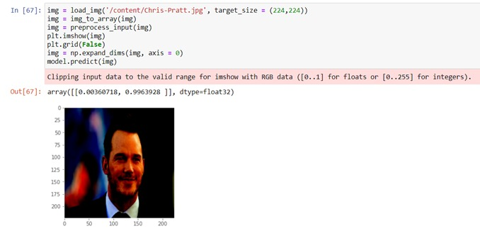
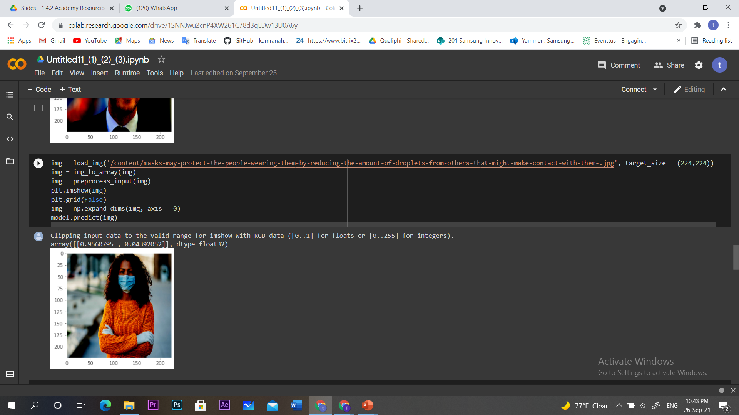
Result :
upload any image of faces with mask or without, the model will predict with high accuracy

Slide 14
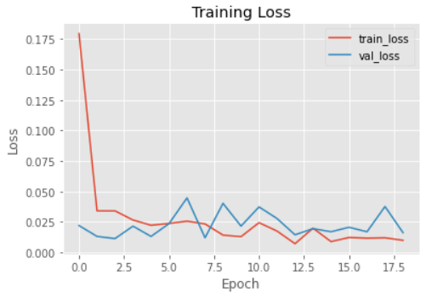
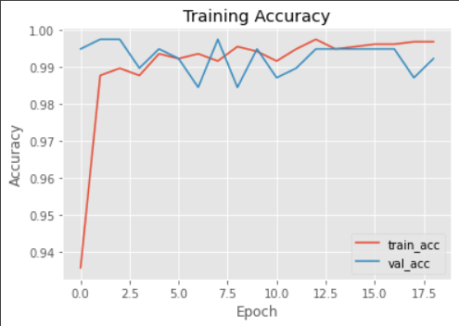
Data scoring :

Slide 15
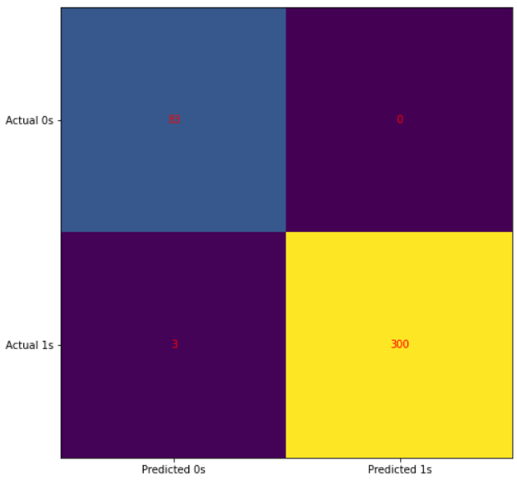
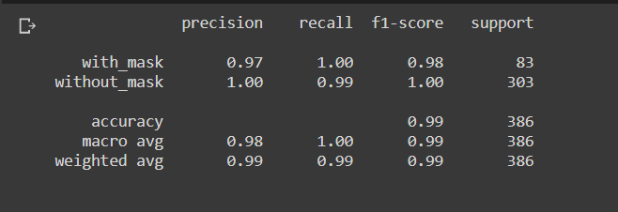
Evolution

Slide 16

Thank You !
Samsung Innovation Campus

